Slide 1

3D Finite-Element Groundwater Flow Modeling of the Semi-Arid Gundlu Sub-Basin Using FEFLOW
BTech CV449 - Major Project – II Presentation
Presented By:
Gowtham R (221CV222)
Kandolu Vasantha Raju (221CV225)
Under the guidance of: Dr. Dwarakish G S Dept. Water Resource & Ocean Engineering
NITK Surathkal
DEPARTMENT OF WATER RESOURCES & OCEAN ENGINEERING NATIONAL INSTITUTE OF TECHNOLOGY KARNATAKA, SURATHKAL
MANGALURU-575025
1

Slide 2
CONTENT :
INTRODUCTION
LITERATURE REVIEW
OBJECTIVES
STUDY AREA
METHODOLOGY
RESULTS AND CONCLUSION
REFERENCES
2

Slide 3
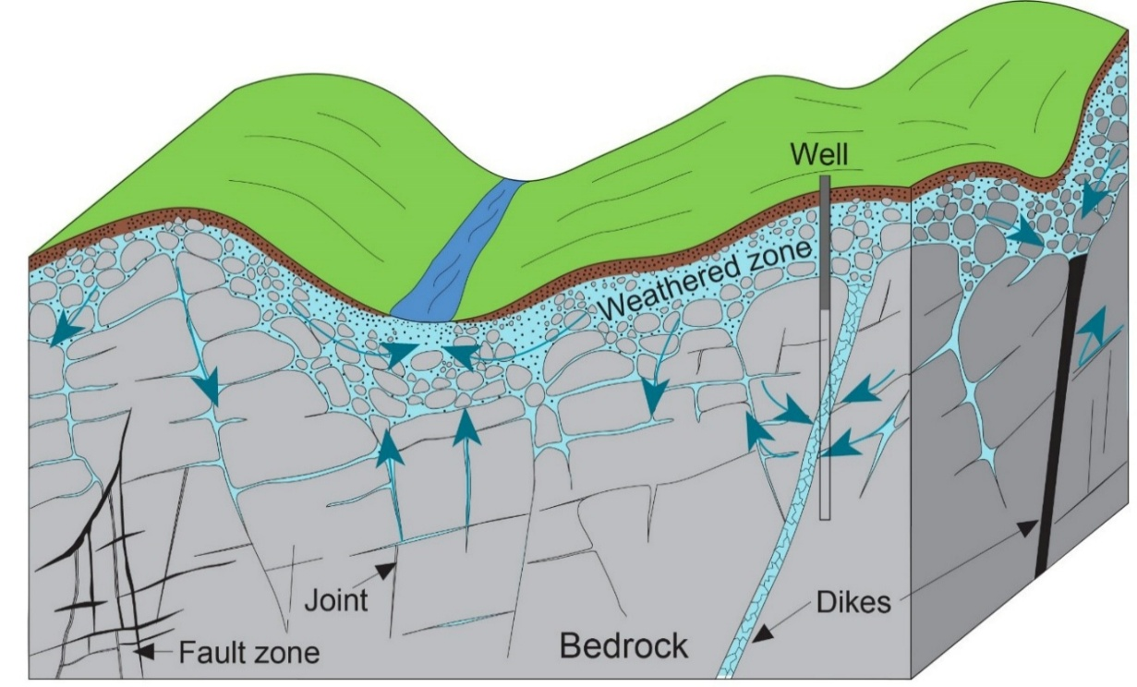
INTRODUCTION :
Groundwater is the primary lifeline for semi-arid regions in the Indian peninsula.
Storage and flow occur within highly heterogeneous weathered and fractured rock zones.
Intensive agricultural demand has led to a critical imbalance between recharge and extraction.
Sustained over-exploitation is projected to cause drastic declines in regional water tables.
Standard porous media assumptions are often insufficient for representing complex fractured systems.
Advanced 3D numerical modeling is essential for evaluating sustainable management policies.
Source: *Modified from Freeze and Cherry, 1979
4

Slide 4

LITERATURE REVIEW :
Author | Title | Year of Publication | Key Conclusion
BHP Billiton | Olympic Dam Expansion – Draft EIS | 2009 | Massive regional scale modelled Deep aquifer systems evaluated Mesh handles localized stresses
Ramstad et al. | Ground source energy in crystalline bedrock | 2010 | Explicit fracture mapping essential Fracturing alters network geometry Network controls overall yield
Ma et al. | Simulation of groundwater level recovery | 2016 | Pipe flow models integrated Fractures simulated as conduits DFEs predict recovery accurately
5

Slide 5
LITERATURE REVIEW :
Author | Title | Year of Publication | Key Conclusion
Yang et al. | Data model for system conceptualization | 2010 | Fractured rock flow modelled Conceptual frameworks translated to grids Clear numerical gridding workflow
Varalakshmi et al. | Groundwater Flow Modeling of a Hard Rock Aquifer: Case Study | 2014 | Two-layer hard-rock model developed Current pumping causes severe decline 40% draft reduction recovers levels
Pareta | Groundwater contamination modelling in Ayad River Basin | 2024 | • Complex geometric data handled • GIS data successfully integrated • High-accuracy numerical modeling achieved
6
6

Slide 6
OBJECTIVES :
Understand groundwater importance, depletion, and complex hard-rock hydrogeology in the semi-arid Gundlu Basin.
Develop a precise 3D finite-element groundwater model using FEFLOW to map weathered and fractured subsurface layers.
Quantify the regional groundwater budget by analyzing dynamic inputs and outputs over a multi-year simulation.
Support sustainable water-use planning by formulating predictive scenarios and testing them through collaborative analysis.
7

Slide 7
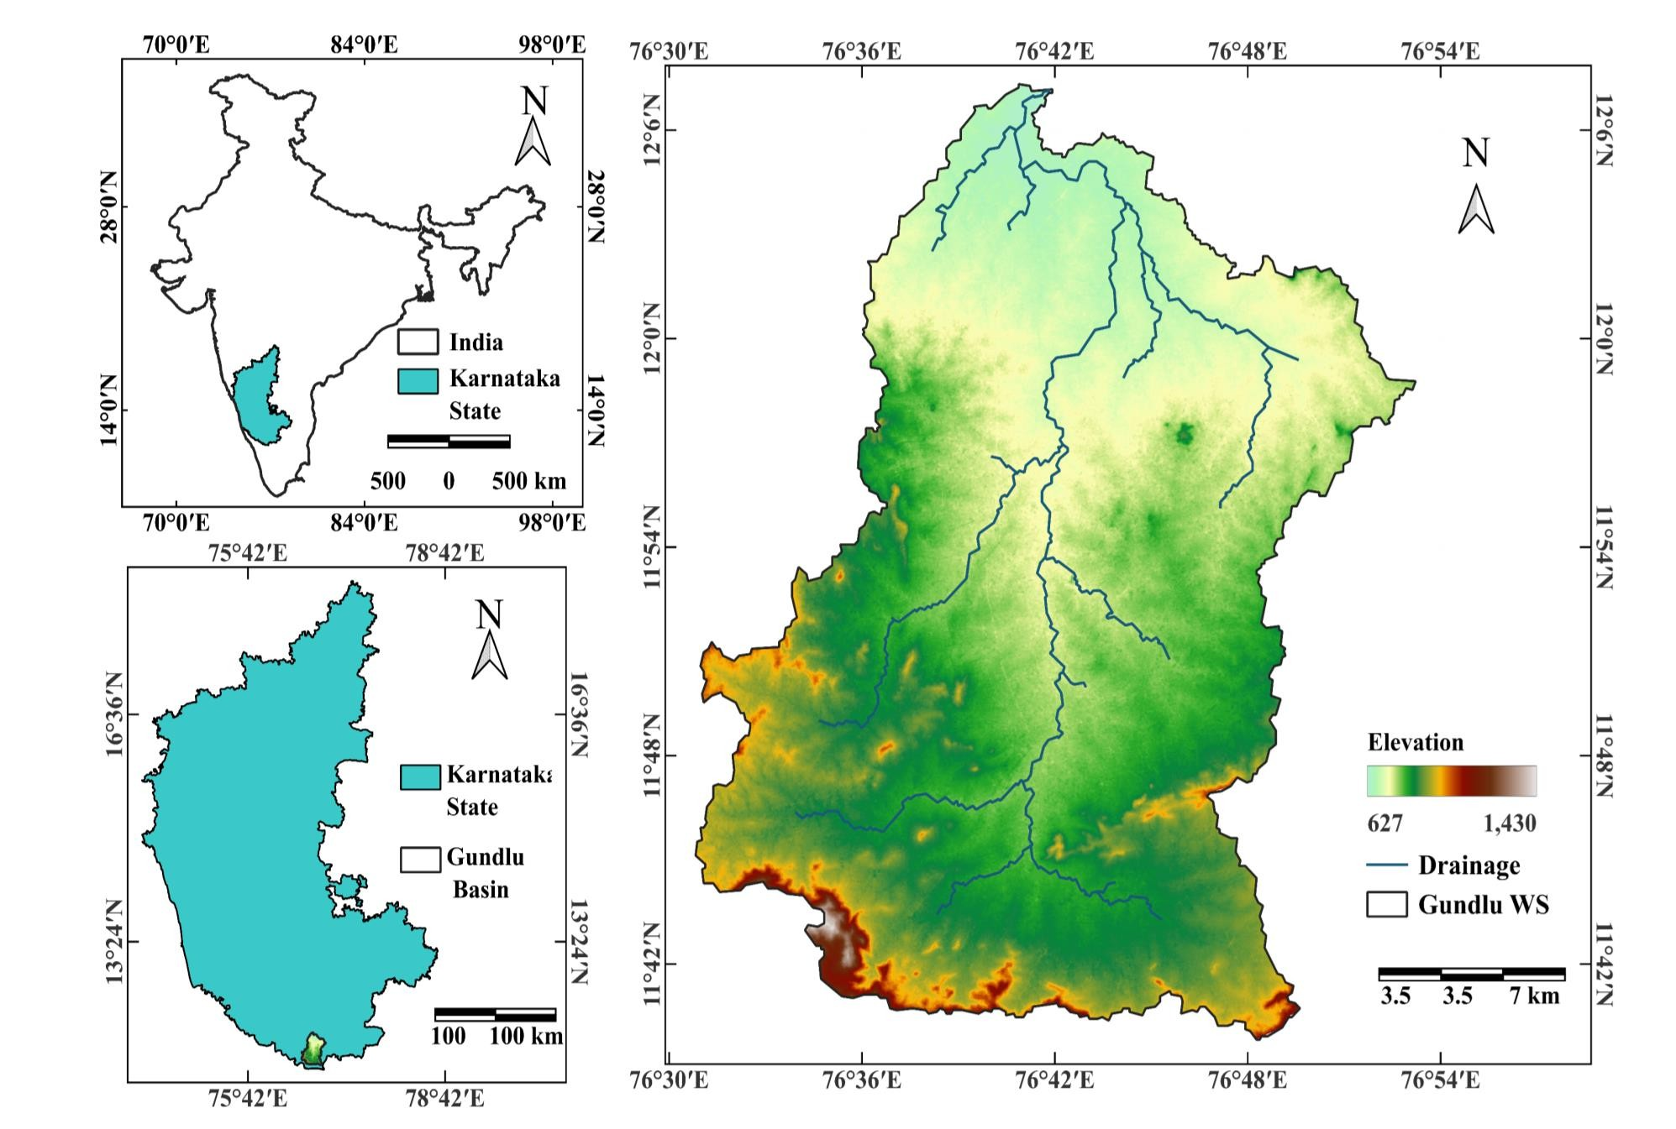
STUDY AREA MAP:
Gundlu Sub-Basin
Tributary of Kabini River
Basin Area : 1,270 km²
Annual Average Rainfall (~600 mm)
Semi-Arid region
Irrigation – Rainfall and groundwater
Significant decline in groundwater levels
8

Slide 8
DATA SETS :
SI.No | Data / Parameter | Source / Agency | Resolution / Scale
1 | DEM Surface | Remote Sensing / DEM Data | Raster grid (elevation surface)
2 | Watershed Boundary | GIS / Basin Delineation | Vector polygon
3 | Stream Shape File | GIS / Hydrology Data | River / stream vector lines
4 | Initial Head | Groundwater Observation / Model Initialization | 500–800 m (typical range)
5 | Recharge Zone | LULC / Recharge Mapping | Vector polygon
6 | RFIF Recharge | Recharge Time-Series Analysis | CSV time-series data
7 | WTF Recharge | Water Table Fluctuation (WTF) Method | CSV recharge dataset
9

Slide 9
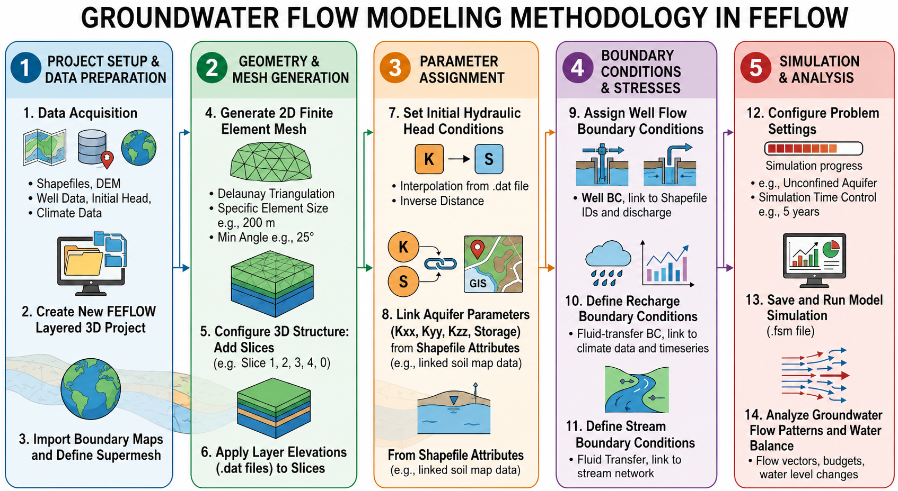
METHODOLOGY :
Source: Generated and refined using OpenAI ChatGPT Image Generation (GPT-5.5), 2026
9

Slide 10
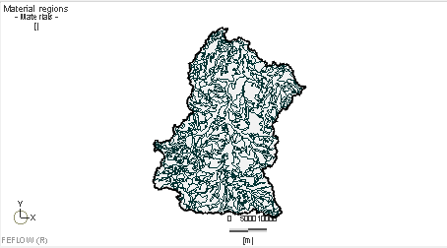
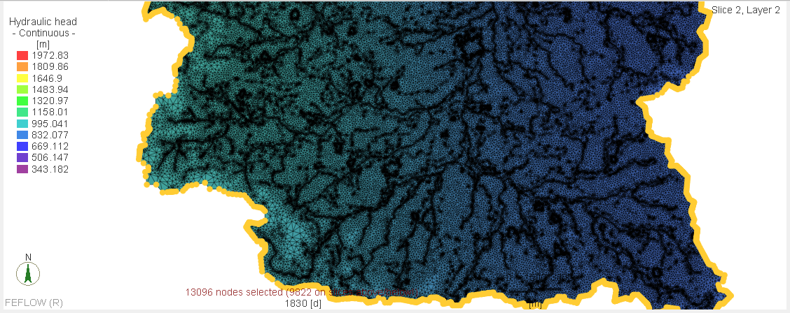
METHODOLOGY :
Soil Surface Distribution and Model with Assigned paramters
10

Slide 11
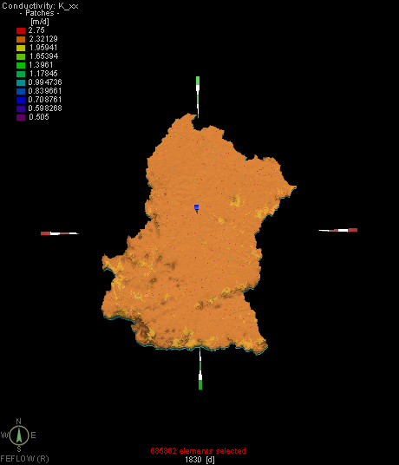
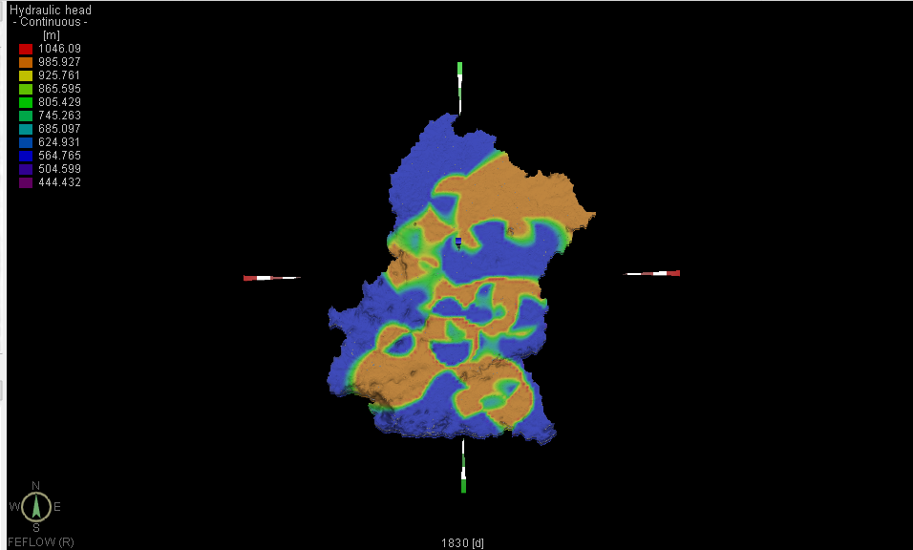
METHODOLOGY :
3D Visuals of Assigned conductivity and hydraulic head paramters
11

Slide 12
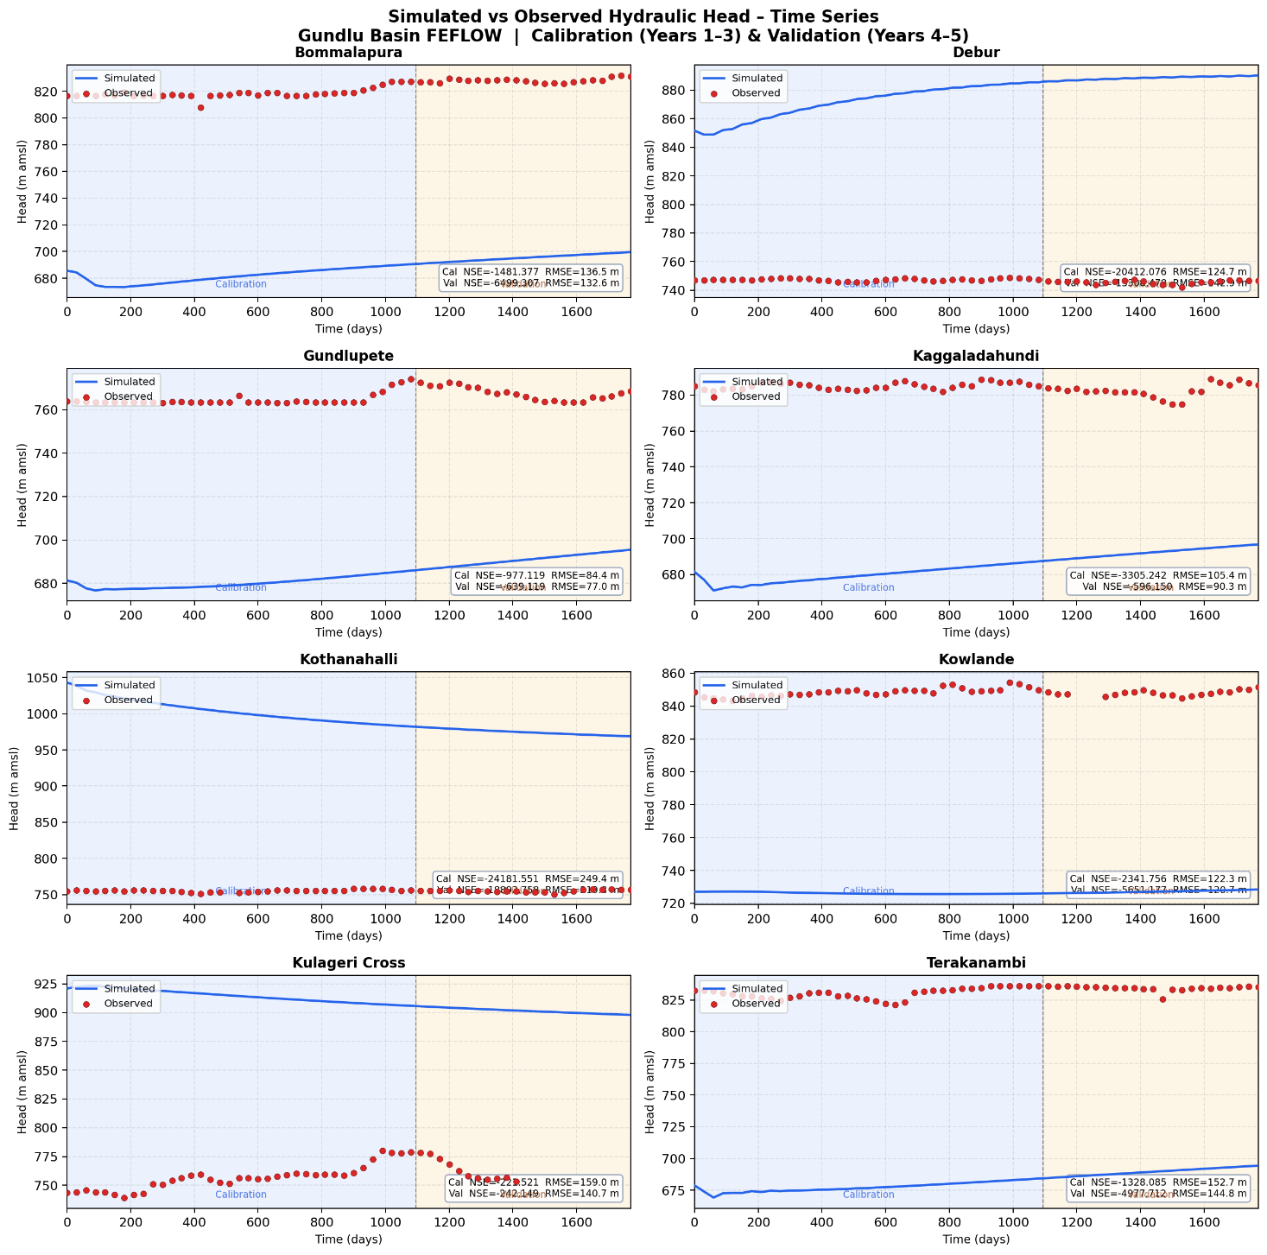
RESULTS AND DISCUSSION :
12

Slide 13
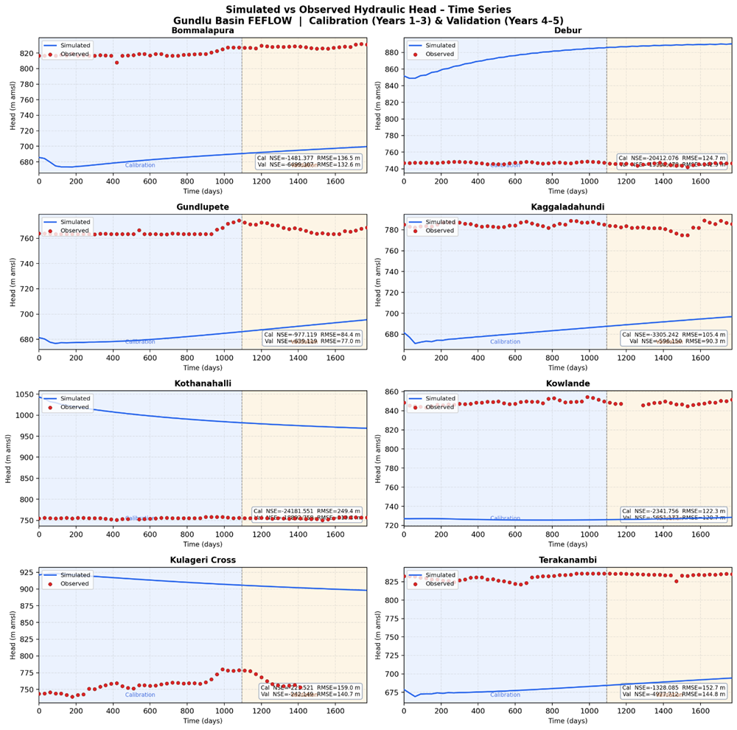
RESULTS AND DISCUSSION :
13

Slide 14
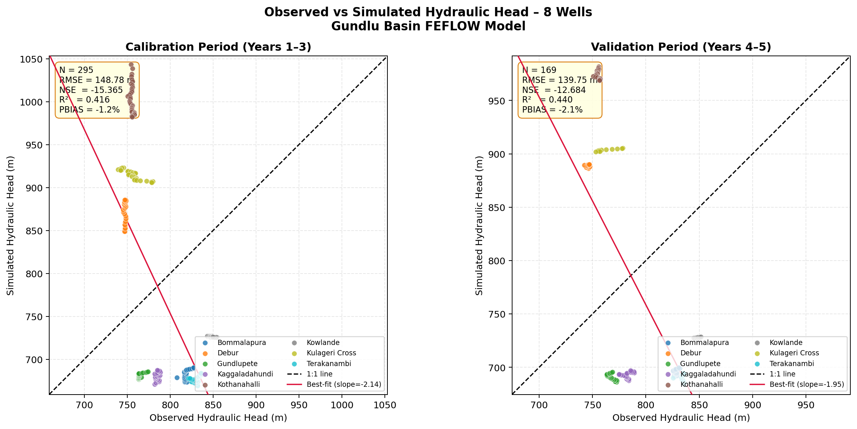
RESULTS AND DISCUSSION :
14

Slide 15
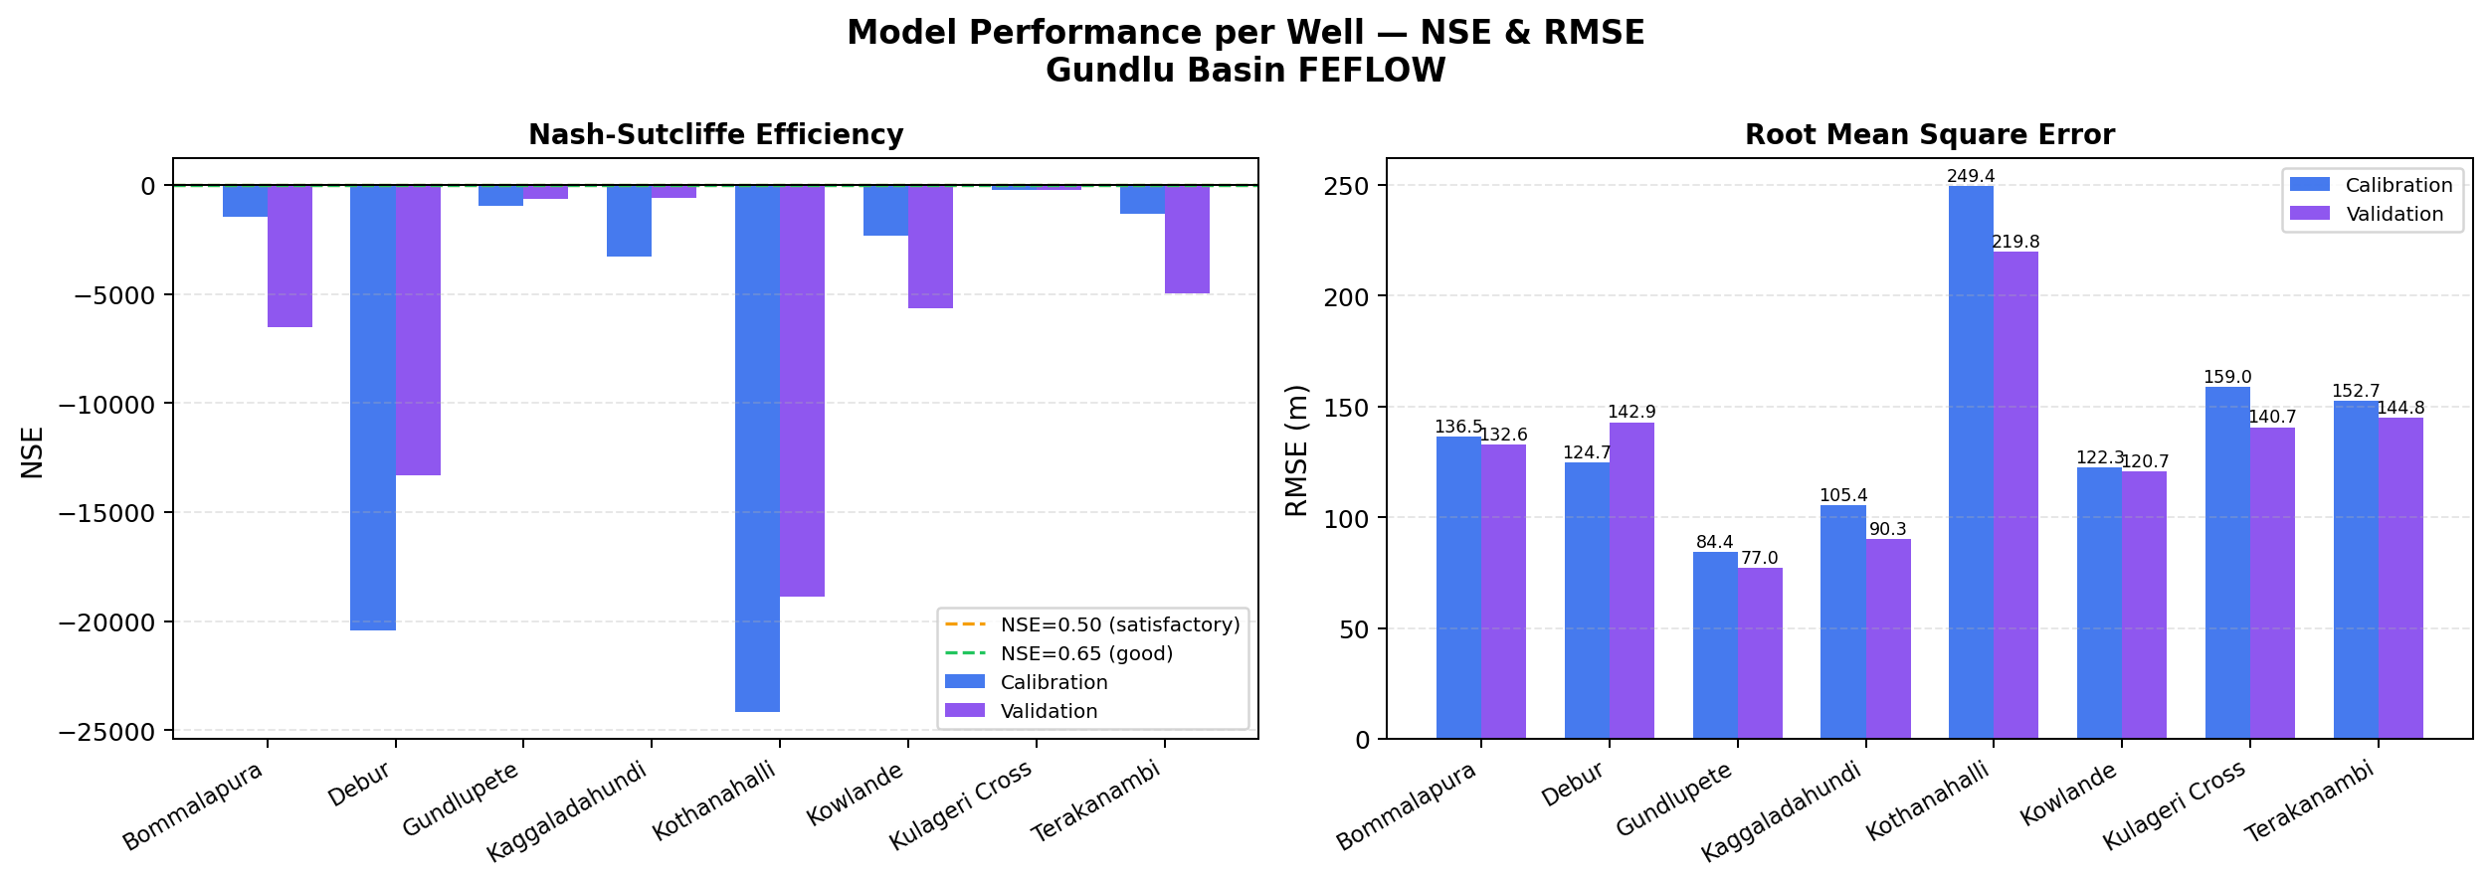
RESULTS AND DISCUSSION :
15

Slide 16
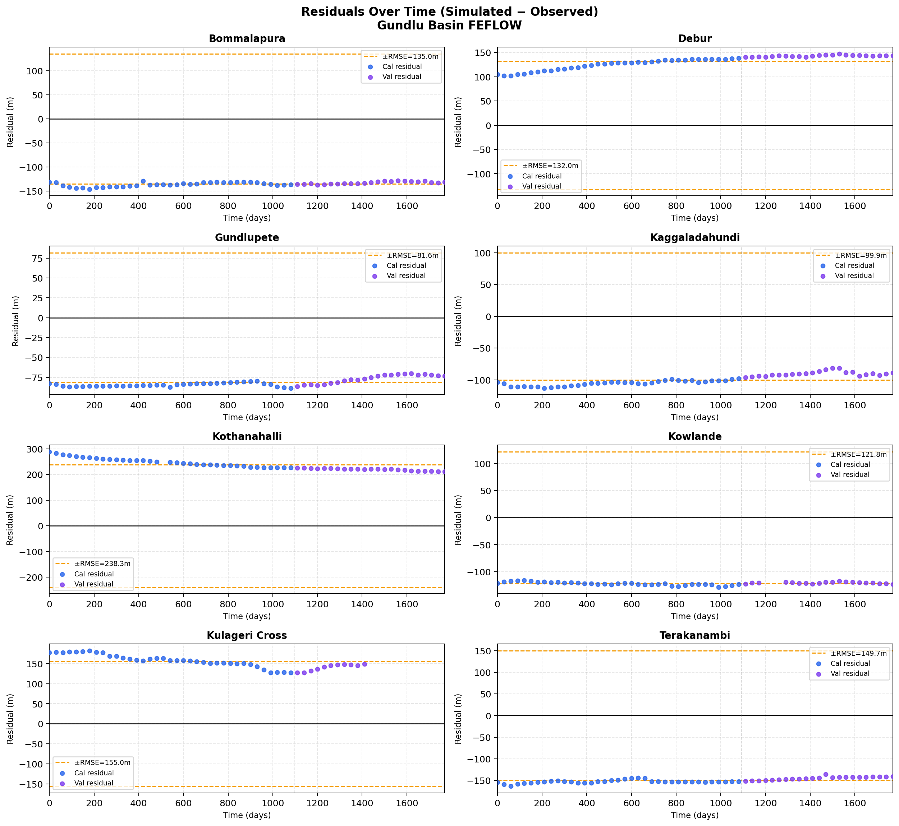
RESULTS AND DISCUSSION :
16

Slide 17
RESULTS AND DISCUSSION :
17

Slide 18
RESULTS AND DISCUSSION :
1. The model is structurally valid, FEFLOW correctly simulates the seasonal groundwater fluctuation pattern. The direction of head change over time follows observed trends ( from R² = 0.40–0.88 and stable residuals).
2. A systematic offset of 75–250 m exists between simulated and observed heads. This is caused by incorrect initial hydraulic head assignment and spatial variation in hydraulic conductivity (K) that has not yet been zone-calibrated. This is a standard pre-calibration condition in groundwater modelling, not a model failure.
3. Fine tuning , Adjust initial heads file correctly, apply zone-based K values and re-run. Gundlupete and Kulageri Cross should be used as primary calibration anchor wells due to their already-better performance.
18

Slide 19
REFERENCES :
Varalakshmi, V., Rao, B. V., Surinaidu, L., and Tejaswini, M. (2014). “Groundwater Flow Modeling of a Hard Rock Aquifer: Case Study.” Journal of Hydrologic Engineering, 19(5), 877–886.
Wang, H. F., and Anderson, M. P. (1982). Introduction to Groundwater Modeling: Finite Difference and Finite Element Methods. W.H. Freeman.
Wada, Y., Van Beek, L. P. H., and Bierkens, M. F. P. (2010). “Global depletion of groundwater resources.” Geophysical Research Letters, 37(20).
Waterloo Hydrogeologic. (2002). Visual MODFLOW User Manual. Waterloo Hydrogeologic Inc., Canada.

Slide 20
REFERENCES :
Alley, W. M., Reilly, T. E., and Franke, O. L. (1999). “Sustainability of Ground-Water Resources.” U.S. Geological Survey Circular, 1186.
Anderson, M. P., and Woessner, W. W. (1992). Applied Groundwater Modeling: Simulation of Flow and Advective Transport. Academic Press.
Briz-Kishore, B. H., and Bhimasankaram, V. L. S. (1982). “Evaluation of aquifer behavior in a typical crystalline basement.” Ground Water, 20(5), 563–568.
Detay, M., Poyet, P., Emsellem, Y., Bernardi, A., and Aubrac, G. (1989). “Development of the Saprolite reservoir and its state of saturation.” Comptes Rendus de l’Académie des Sciences, 309, 429–436.

Slide 21
THANK YOU

